Slide 1
Programming With C++/R
DST102TC
Huakang Li
Huakang.li@xjtlu.edu.cn
School of AI and Advanced Computing
Notes:
English Title: Uppercase, Calibri size 60, XJTLU Navy
English Subtitle: Uppercase, Calibri size 36, XJTLU Navy

Slide 2
Chapter 14
Operator Overloading
Notes:
English Title: Uppercase, Calibri size 60, XJTLU Navy
English Subtitle: Uppercase, Calibri size 36, XJTLU Navy

Slide 3
Objectives
To define the Rational class for creating rational numbers (§14.2).
To discover how an operator can be overloaded in C++ using a function (§14.3).
To overload the relational operators (<, <=, =, !=, >=, >) and arithmetic operators (+, -, *, /) (§14.3).
To overload the subscript operator [] (§14.4).
To overload the shorthand assignment operators +=, -=, *=, and /= (§14.5).
To overload the unary operators + and - (§14.6).
To overload the prefix and postfix ++ and –- operators (§14.7).
To enable friend functions and friend classes to access a class’s private members (§14.8).
To overload the stream insertion and extraction operators << and >> as friend non-member functions (§14.9).
To define operator functions to perform object conversions to a primitive type (§14.10.1).
To define appropriate constructors to perform conversions from a numeric value to an object type (§14.10.2).
To define a new Rational class with overloaded operators (§14.11).
To overload the = operator to perform a deep copy (§14.12).

Slide 4
Function operators in string and vector
string s1("Washington");
string s2("California");
cout << "The first character in s1 is " << s1[0] << endl;
cout << "s1 + s2 is " << (s1 + s2) << endl;
cout << "s1 < s2? " << (s1 < s2) << endl;
vector<int> v;
v.push_back(3);
v.push_back(5);
cout << "The first element in v is " << v[0] << endl;

Slide 5
Function operators in string and vector
string s1("Washington");
string s2("California");
cout << "The first character in s1 is " << s1.operator[](0) << endl;
cout << "s1 + s2 is " << operator+(s1, s2) << endl;
cout << "s1 < s2? " << operator<(s1, s2) << endl;
vector<int> v;
v.push_back(3);
v.push_back(5);
cout << "The first element in v is " << v.operator[](0) << endl;

Slide 6
The Rational Class

Slide 7
requirements
A rational number has a numerator and a denominator in the form a/b, where a is the numera- tor and b is the denominator.
Please wirte a program, that you can add, subtract, multiply, divide, and compare rational numbers. You can also convert a rational number into an integer, floating-point value, or string.

Slide 8
TestRationalClass.cpp
Rational.h
Rational.cpp
#include <iostream>
#include "Rational.h"
using namespace std;
int main()
{
// Create and initialize two rational numbers r1 and r2.
Rational r1(4, 2);
Rational r2(2, 3);
// Test toString, add, subtract, multiply, and divide
cout << r1.toString() << " + " << r2.toString() << " = "
<< r1.add(r2).toString() << endl;
cout << r1.toString() << " - " << r2.toString() << " = "
<< r1.subtract(r2).toString() << endl;
cout << r1.toString() << " * " << r2.toString() << " = "
<< r1.multiply(r2).toString() << endl;
cout << r1.toString() << " / " << r2.toString() << " = "
<< r1.divide(r2).toString() << endl;
// Test intValue and double
cout << "r2.intValue()" << " is " << r2.intValue() << endl;
cout << "r2.doubleValue()" << " is " << r2.doubleValue() << endl;
// Test compareTo and equal
cout << "r1.compareTo(r2) is " << r1.compareTo(r2) << endl;
cout << "r2.compareTo(r1) is " << r2.compareTo(r1) << endl;
cout << "r1.compareTo(r1) is " << r1.compareTo(r1) << endl;
cout << "r1.equals(r1) is "
<< (r1.equals(r1) ? "true" : "false") << endl;
cout << "r1.equals(r2) is "
<< (r1.equals(r2) ? "true" : "false") << endl;
return 0;
}
To Do
To Do

Slide 9
Operator Functions
bool Rational::operator<(Rational &secondRational)
{
return compareTo(secondRational) < 0
}

Slide 10
Overloadable Operators

Slide 11
Operators That Cannot Be Overloaded

Slide 12
Precedence and Associativity
C++ defines the operator precedence and associativity (see §3.12, “Operator Precedence and Associativity.”)
You cannot change the operator precedence and associativity by overloading.

Slide 13
< Function Operator
bool Rational::operator<(const Rational &secondRational) const
{
// compareTo is already defined Rational.h
if (compareTo(secondRational) < 0)
return true;
else
return false;
}
Rational r1(4, 2);
Rational r2(2, 3);
cout << "r1 < r2 is " << (r1.operator<(r2) ? "true" : "false");
cout << "\nr1 < r2 is " << ((r1 < r2) ? "true" : "false");
cout << "\nr2 < r1 is " << (r2.operator<(r1) ? "true" : "false");

Slide 14
+ Function Operator
Rational Rational::operator+(const Rational &secondRational) const
{
// add is already defined Rational.h
return add(secondRational);
}
Rational r1(4, 2);
Rational r2(2, 3);
cout << "r1 + r2 is " << (r1 + r2).toString() << endl;

Slide 15
Overloading the [] Operators
int Rational::operator[](int index)
{
if (index == 0)
return numerator;
else if (index == 1)
return denominator;
else
{
throw runtime_error("subscript out of range");
}
}

Slide 16
[] accessor and mutator
The [] operator functions as both accessor and mutator. For example, you use r2[0] as an accessor to retrieve the numerator in an expression, and use r2[0] = value as a mutator. After adding this operator to the Rational class, the Rational class is mutable.

Slide 17
Correct Overloading of the [] Operators
int Rational::&operator[](int index)
{
if (index == 0)
return numerator;
else if (index == 1)
return denominator;
else
{
throw runtime_error("subscript out of range");
}
}

Slide 18
Overloading the Augmented (Compound) Operators
C++ has shorthand operators +=, -=, *=, and /= for adding, subtracting, multiplying, and dividing a value in a variable. You can overload these operators in the Rational class.
Rational& Rational::operator+=(const Rational &secondRational)
{
*this = add(secondRational);
return *this;
}

Slide 19
Overloading the Shorthand Operators
Rational r1(2, 4);
Rational r2 = r1 += Rational(2, 3);
cout << "r1 is " << r1.toString() << endl;
cout << "r2 is " << r2.toString() << endl;

Slide 20
Overloading the [] Operators
In C++, the subscript [] is an operator. You can overload this operator to access the contents of the object using the array-like syntax if desirable. For example, you may wish to access the numerator and denominator using r[0] and r[1].

Slide 21
Overloading the Unary Operators
The + and - are unary operators.
They can be overloaded too. Since the unary operator operates on one operand that is the calling object itself, the unary function operator has no parameters.
Rational Rational::operator-()
{
return Rational(-numerator, denominator);
}

Slide 22
Overloading the ++ and -- Operators
The ++ and -- operators may be prefix or postfix. The prefix ++var or --var first adds or subtracts 1 from the variable and then evaluates to the new value in the var. The postfix var++ or var-- adds or subtracts 1 from the variable, but evaluates to the old value in the var.
If the ++ and -- are implemented correctly, the following code
r3 = r1++;
r3 = ++r1;
r1--;
++r1;
--r1;

Slide 23
Overloading the ++ and – Operators, cont.
Rational Rational::operator++()
{
numerator += denominator;
return *this;
}
Rational Rational::operator++(int dummy)
{
Rational temp(numerator, denominator);
numerator += denominator;
return temp;
}

Slide 24
Friend Functions and Classes
C++ allows you to overload the stream insertion operator (<<) for outputting to cout and overload the stream extraction operator (>>) for reading values from cin.
To overload these two operators, you need to use the friend functions. This section introduces friend functions and friend classes.

Slide 25
Friend Functions and Classes
Private members of a class cannot be accessed from outside of the class.
Occasionally, it is convenient to allow some trusted functions and classes to access a class’s private members.
C++ enables you to use the friend keyword to declare friend functions and friend classes for a class so these functions and classes can access the class’s private members.

Slide 26
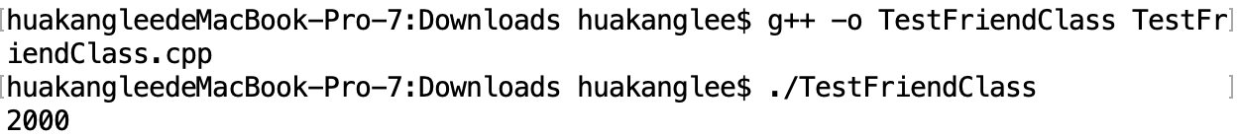
Friend Classes
Date.h
TestFriendClass.cpp
#include <iostream>
#include "Date.h"
using namespace std;
class AccessDate
{
public:
static void p()
{
Date birthDate(2010, 3, 4);
birthDate.year = 2000;
cout << birthDate.year << endl;
}
};
int main()
{
AccessDate::p();
return 0;
}
#ifndef DATE_H
#define DATE_H
class Date
{
public:
Date(int year, int month, int day)
{
this->year = year;
this->month = month;
this->day = day;
}
friend class AccessDate;
private:
int year;
int month;
int day;
};
#endif

Slide 27
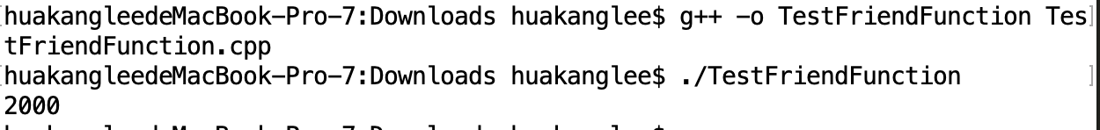
TestFriendFunction.cpp
#include <iostream>
using namespace std;
class Date
{
public:
Date(int year, int month, int day)
{
this->year = year;
this->month = month;
this->day = day;
}
friend void p();
private:
int year;
int month;
int day;
};
void p()
{
Date date(2010, 5, 9);
date.year = 2000;
cout << date.year << endl;
}
int main()
{
p();
return 0;
}

Slide 28
Overloading the << and >> Operators
C++ allows you to overload the stream insertion operator (<<) for sending an object to cout and overload the stream extraction operator (>>) for reading values from cin. Overloading these two operators is different from other operators you have seen in this chapter. Since the first parameter of the << (>>) operator is an instance of ostream (istream), these two operators are defined in the ostream and istream classes, not in the Rational class.
cout << r1 << " followed by " << r2;
This is equivalent to
((cout << r1) << " followed by ") << r2;

Slide 29
Overloading the << and >> Operators
ostream& operator<<(ostream& out, const Rational &rational)
{
out << rational.numerator << "/" << rational.denominator;
return out;
}

Slide 30
Overloading the << and >> Operators
istream& operator>>(istream& in, Rational& rational)
{
cout << "Enter numerator: ";
in >> rational.numerator;
cout << "Enter denominator: ";
in >> rational.denominator;
return in;
}

Slide 31
Type Conversion: Rational to double
You can add an int value with a double value such as
4 + 5.5
In this case, C++ performs automatic type conversion to convert an int value 4 to a double value 4.0.
Can you add a rational number with an int or a double value? Yes. You have to define a function operator to convert an object into int or double. Here is the implementation of the function to convert a Rational object to a double value.

Slide 32
Rational to double
Rational::operator double()
{
return doubleValue();
}
Rational r1(1, 4);
double d = r1 + 5.1;
cout << "r1 + 5.1 is " << d << endl;

Slide 33
Type Conversion: number to Rational
A Rational object can be automatically converted to a numeric value. Can a numeric value be automatically converted to a Rational object? The answer is yes.
To achieve this, define the following constructor in the header file
Rational(int numerator);
and implement it in the implementation file .

Slide 34
Type Conversion: number to Rational
Provided that the + operator is also overloaded (see §14.3), the following code
Rational r1(2, 3);
Rational r = r1 + 4; // Automatic converting 4 to Rational
cout << r << endl;
displays
14 / 3

Slide 35
Type Conversion: number to Rational
You can add a Rational object with an integer like this:
r1 + 4 (r1.operator+(4))
Can you add an integer with a Rational object like this:
4 + r1 (4.operator+(r1)???)
Naturally you would think the + operator is symmetric. However, it does not work. Why?

Slide 36
The New Rational Class
The preceding sections introduced how to overload function operators. You are ready to give a new Rational class with all appropriate function operators.
RationalWithOperators.h
RationalWithOperators.cpp
TestRationalWithOperators.cpp

Slide 37
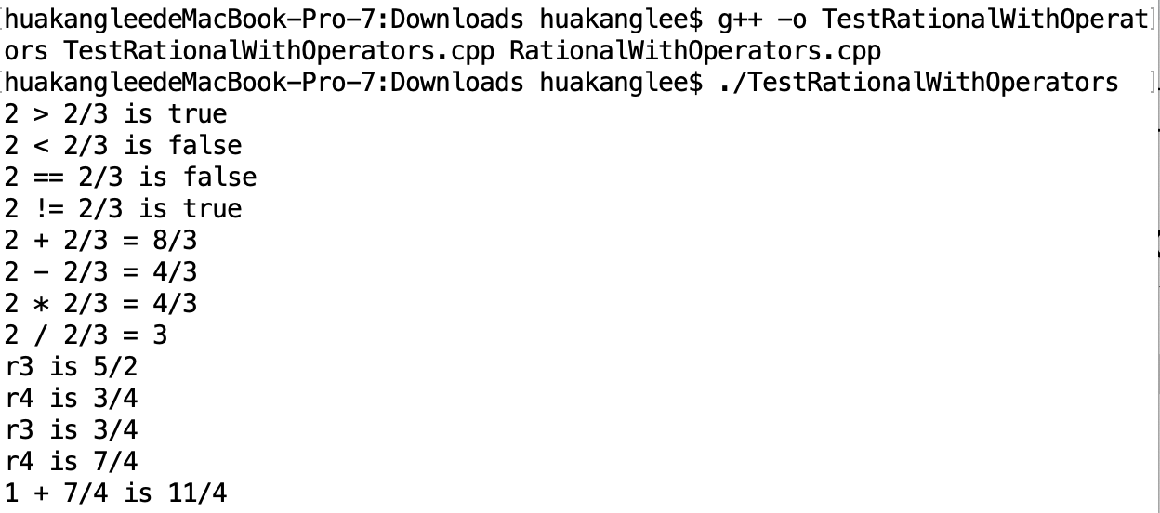
TestRationalWithOperators.cpp
#include <iostream>
#include <string>
#include "RationalWithOperators.h"
using namespace std;
int main()
{
// Create and initialize two rational numbers r1 and r2.
Rational r1(4, 2);
Rational r2(2, 3);
// Test relational operators
cout << r1 << " > " << r2 << " is " <<
((r1 > r2) ? "true" : "false") << endl;
cout << r1 << " < " << r2 << " is " <<
((r1 < r2) ? "true" : "false") << endl;
cout << r1 << " == " << r2 << " is " <<
((r1 == r2) ? "true" : "false") << endl;
cout << r1 << " != " << r2 << " is " <<
((r1 != r2) ? "true" : "false") << endl;
// Test toString, add, subtract, multiply, and divide operators
cout << r1 << " + " << r2 << " = " << r1 + r2 << endl;
cout << r1 << " - " << r2 << " = " << r1 - r2 << endl;
cout << r1 << " * " << r2 << " = " << r1 * r2 << endl;
cout << r1 << " / " << r2 << " = " << r1 / r2 << endl;
// Test augmented operators
Rational r3(1, 2);
r3 += r1;
cout << "r3 is " << r3 << endl;
// Test function operator []
Rational r4(1, 2);
r4[0] = 3; r4[1] = 4;
cout << "r4 is " << r4 << endl;
// Test function operators for prefix ++ and --
r3 = r4++;
cout << "r3 is " << r3 << endl;
cout << "r4 is " << r4 << endl;
// Test function operator for conversion
cout << "1 + " << r4 << " is " << (1 + r4) << endl;
return 0;
}

Slide 38
Overloading the = Operator
By default, the = operator performs a memberwise copy from one object to the other. For example, the following code copies r2 to r1.
Rational r1(1, 2);
Rational r2(4, 5);
r1 = r2;
cout << "r1 is " << r1.toString() << endl;
cout << "r2 is " << r2.toString() << endl;

Slide 39
DefaultAssignmentDemo.cpp
#include <iostream>
#include "CourseWithCustomCopyConstructor.h" // See Listing 11.19
using namespace std;
int main()
{
Course course1("Java Programming", 10);
Course course2("C++ Programming", 14);
course2 = course1;
course1.addStudent("Peter Pan"); // Add a student to course1
course2.addStudent("Lisa Ma"); // Add a student to course2
cout << "students in course1: " <<
course1.getStudents()[0] << endl;
cout << "students in course2: " <<
course2.getStudents()[0] << endl;
return 0;
}

Slide 40
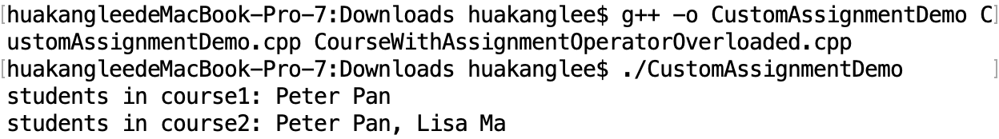
CustomAssignmentDemo.cpp
#include <iostream>
#include "CourseWithAssignmentOperatorOverloaded.h"
using namespace std;
void printStudent(string names[], int size)
{
for (int i = 0; i < size; i++)
cout << names[i] << (i < size - 1 ? ", " : " ");
}
int main()
{
Course course1("Java Proramming", 10);
course1.addStudent("Peter Pan"); // Add a student to course1
Course course2("C++ Programming", 10);
course2 = course1; // Create course2 as a copy of course1
course2.addStudent("Lisa Ma"); // Add a student to course2
cout << "students in course1: ";
printStudent(course1.getStudents(), course1.getNumberOfStudents());
cout << endl;
cout << "students in course2: ";
printStudent(course2.getStudents(), course2.getNumberOfStudents());
cout << endl;
return 0;
}

Slide 41
Overloading the = Operator
To change the way the default assignment operator = works, you need to overload the = operator. In the Couse.h file, define
const Course& operator=(const Course& course)
Why the return type is Course not void? C++ allows multiple assignments such as:
course1 = course2 = course3;
In this statement, course3 is copied to course2, and then returns course2, and then course2 is copied to course1. So the = operator must have a valid return value type.

Slide 42
Rule of Three
The copy constructor, the = assignment operator, and the destructor are called the rule of three, or the Big Three.
If they are not defined explicitly, all three are created by the compiler automatically.
You should customize them if the class contains a pointer data field.
If you have to customize one of the three, you should customize the other two as well.

Slide 43
summarization
Function operators
Friend Functions and Classes
Type Conversion
Rule of Three

Slide 44



THANK YOU
Visit us
FOLLOW us
www.xjtlu.edu.cn
Notes:
Title: Uppercase, Calibri size 60, XJTLU Navy

